Slide 1
Introduction to Cloud Applications (I) Lecture 2: Application Architecture
© Donald F. Ferguson, 2022

Slide 2

Contents
2 | Introduction to Cloud Applications (I) – Lecture 2: Application Architecture © Donald F. Ferguson, 2022

Slide 3
Contents
Course checkpoint.
Answering Ansys specific questions (1).
VMs and containers – introduction.
Application structure:
Full stacks basics.
Angular application quick overview.
Local architecture.
Deployment architecture I.
Introduction to REST.
Introduction to Database-as-a-Service (DBaaS).

Slide 4
Course Checkpoint
4 | Introduction to Cloud Applications (I) – Lecture 2: Application Architecture © Donald F. Ferguson, 2022

Slide 5
Course Checkpoint
We are looking at feedback from initial lecture.

Slide 6
Ansys Question
6 | Introduction to Cloud Applications (I) – Lecture 2: Application Architecture © Donald F. Ferguson, 2022

Slide 7
Ansys Questions
“I scanned the syllabus for your upcoming intro to cloud applictions. The contents look great, and I'm looking forward to attending.
I didn't see in the syllabus some Ansys-specific topics that I and some of the others in the Apex office are trying to understand. Perhaps you can shed some light on these or point me to the right person(s). I can imagine a bunch of these issues are still being explored and many not have concise answers. Maybe an overview of Ansys cloud activities and how they relate or differ might be warranted for one of the Tuesday AM SPBU presentations. Given that, here are the sorts of questions I and the others are trying to understand:
Ansys seems to have several cloud related activities occurring. How do "Ansys Cloud", "Ansys Platform on Demand", Ansys' partnership with Azure, and Ansys' partnership with AWS all fit together? In particular, how as an Ansys developer and product implementer (... ...) should we view these and develop for these? Ditto for running "on prem" with a customer's internal cloud. How should we as software developers address all these options? Is making our products available in a Docker Image the goal, part of the goal, an alternative to the goal, etc.? How as an Ansys developer should we be appropriately accessing these resources (Ansys Cloud, Azure, AWS, APOD) in the course of development and testing? While this is still extremely new, how does OnScale and their technology fit into all of this, and how does it supplement and/or replace existing Ansys efforts? How and/or who is determining how Ansys applications in the cloud should best address large data (think large scale Fluent transient) and distributed memory parallelism (MPI in the cloud across dozens to hundreds of nodes)? When developing a PyAnsys-like interface to a product (... ...), what are the cloud relevant issues from an Ansys point-of-view that come into play and where/who do we find those out?
As a developer, I (and my colleagues) am trying to make sense of all of this, where to aim development in terms of the Cloud (Ansys specifics and not just cloud generic), and how to appropriately and effectively integrate with other Ansys efforts.”

Slide 9
Initial Feedback
9 | Introduction to Cloud Applications (I) – Lecture 2: Application Architecture © Donald F. Ferguson, 2022

Slide 10
Initial Feedback
“I scanned the syllabus for your upcoming intro to cloud applictions. The contents look great, and I'm looking forward to attending.
I didn't see in the syllabus some Ansys-specific topics that I and some of the others in the Apex office are trying to understand. Perhaps you can shed some light on these or point me to the right person(s). I can imagine a bunch of these issues are still being explored and many not have concise answers. Maybe an overview of Ansys cloud activities and how they relate or differ might be warranted for one of the Tuesday AM SPBU presentations. Given that, here are the sorts of questions I and the others are trying to understand:
Ansys seems to have several cloud related activities occurring. How do "Ansys Cloud", "Ansys Platform on Demand", Ansys' partnership with Azure, and Ansys' partnership with AWS all fit together? In particular, how as an Ansys developer and product implementer (... ...) should we view these and develop for these? Ditto for running "on prem" with a customer's internal cloud. How should we as software developers address all these options? Is making our products available in a Docker Image the goal, part of the goal, an alternative to the goal, etc.? How as an Ansys developer should we be appropriately accessing these resources (Ansys Cloud, Azure, AWS, APOD) in the course of development and testing? While this is still extremely new, how does OnScale and their technology fit into all of this, and how does it supplement and/or replace existing Ansys efforts? How and/or who is determining how Ansys applications in the cloud should best address large data (think large scale Fluent transient) and distributed memory parallelism (MPI in the cloud across dozens to hundreds of nodes)? When developing a PyAnsys-like interface to a product (... ...), what are the cloud relevant issues from an Ansys point-of-view that come into play and where/who do we find those out?
As a developer, I (and my colleagues) am trying to make sense of all of this, where to aim development in terms of the Cloud (Ansys specifics and not just cloud generic), and how to appropriately and effectively integrate with other Ansys efforts.”

Slide 11
Introduction to Core Concepts
11 | Introduction to Cloud Applications (I) – Lecture 1: Introduction, Concepts © Donald F. Ferguson, 2022

Slide 12
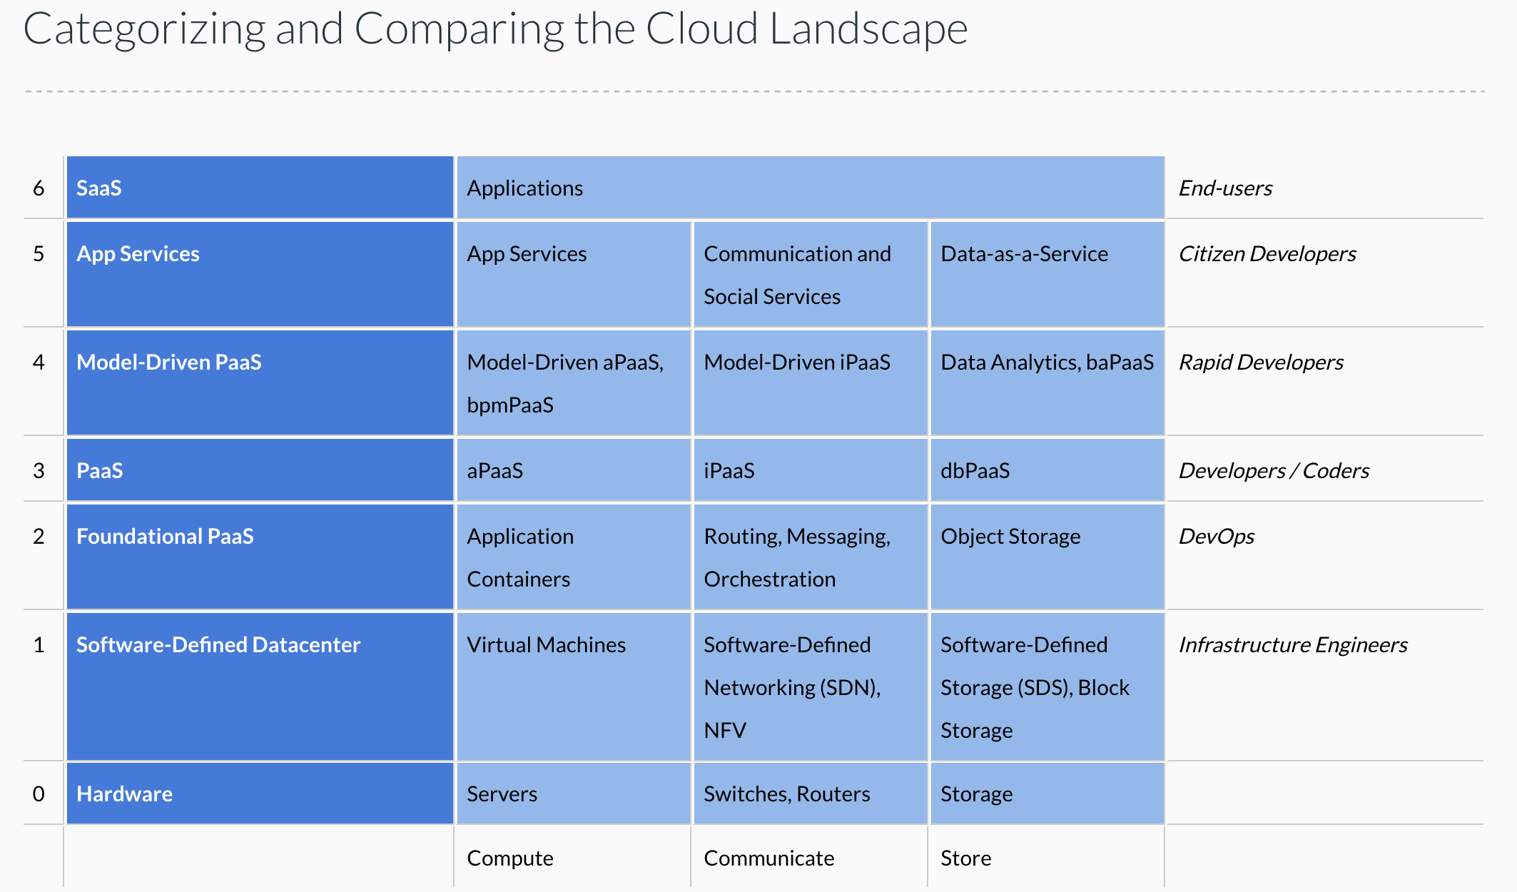
Cloud Concepts – One Perspective
http://www.theenterprisearchitect.eu/blog/2013/10/12/the-cloud-landscape-described-categorized-and-compared/

Slide 13
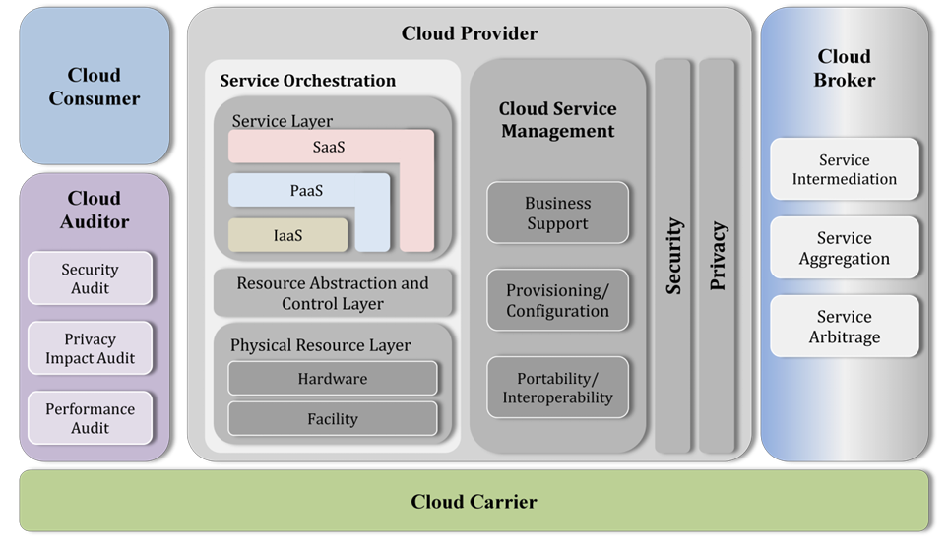
Cloud Concepts – Another Perspective
NIST Cloud Computing Reference Architecture

Slide 14
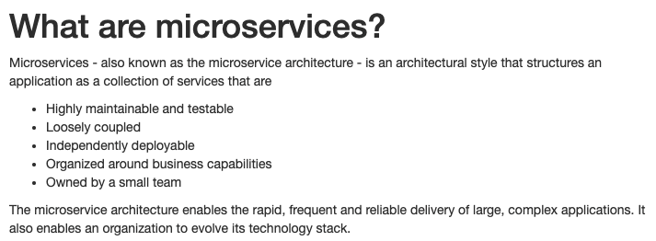
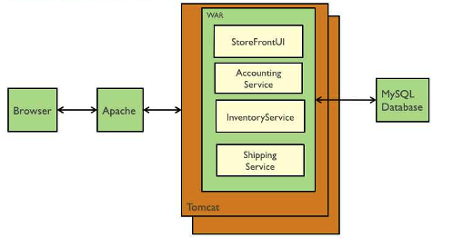
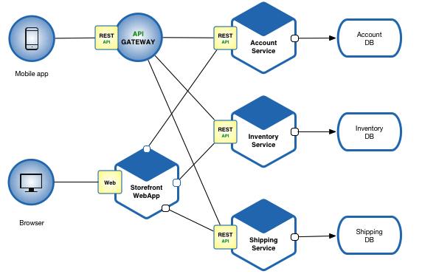
Microservices (https://microservices.io/index.html)
The literature discussed microservices in the context of “web applications.”
The approach does apply to building CAE products.
We think of our products as a logical set of subsystems/components. Microservices
Replace “language runtime linking”
With a more flexible approach to
Product development and assembly.
Microservices Architecture
Monolithic Architecture

Slide 15
Classification, Definitions, Pros/Cons
What is true of any:
Mapping, classification, taxonomy, ... ...?
Technology definition, ... ...?
Enumeration of technology pros and cons ... ...?
Answers:
“... ... it is ... ... More honor'd in the breach than the observance”
If you have three subject matter experts, you have 7 conflicting opinions.
”The most dangerous thing in the world is a 2nd LT with a map.” Like any map, it is both a way of orientating yourself and a way of having a spectacular disaster because you are studying the map instead of thinking.
When you transform monolithic systems to
Containers, microservices, cloud, ... ...
You initially have some pretty “Macro” microservices and containers.
APIs, SaaS and the cloud allow you to “hide a lot of ugly by putting ‘lipstick on the pig.’”
Transformation occurs through continuous improvement.

Slide 16
First Application and Microservice
16 | Introduction to Cloud Applications (I) – Lecture 1: Introduction, Concepts © Donald F. Ferguson, 2022

Slide 17
First Microservice
There are four distinct phases. The workflow becomes more sophisticated later:
Develop and test SW: In this example:
Develop and unit test:
Database
Data service
Application “resource,” which will be foundation for REST
Develop and test SW system by assembling components and application application container to form microservice.
Define and configure Infrastructure-as-a-Service:
Virtual machine (server, storage, networking).
Install and test supporting infrastructure SW.
Deploy and configure microservice, and test on IaaS.

Slide 18
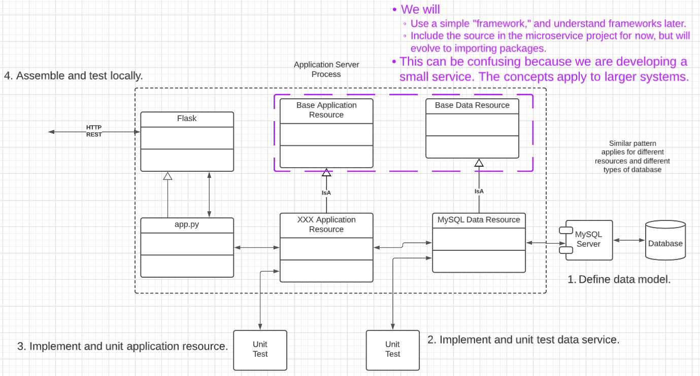
Software Development Overview

Slide 19
Environment
We are working on getting students credits to use Amazon Web Services.
The first lecture and example starts with developing on your computer.
I will show the basics of the first deployment to AWS. Hopefully, we will receive credits within a few days.
Computer environment:
Integrated Development Environment (IDE):
“Real programmers don’t need no stinkin’ IDE.”
I use the JetBrains products.
I have a professional license because I am a professor.
Ansys has some licenses but I do not know the details.
You should be fine using the free community editions or VS Code.
I will use MySQL for my local RDBMs.
We will switch over to cloud databases (DB-as-a-Service).
You will be OK with SQLite for the first examples.

Slide 20
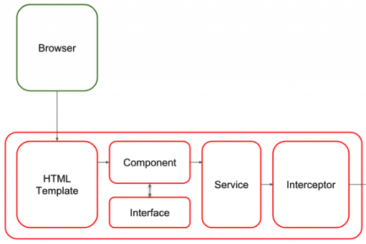
Overall Structure
API First: All services have a well-defined API.
”The UI” is one of many applications that use the API.
Runtime Container
Application Container
Other UIs.
Other services.
... ...
Binding
Middleware
Application Service
Data Service

Slide 21
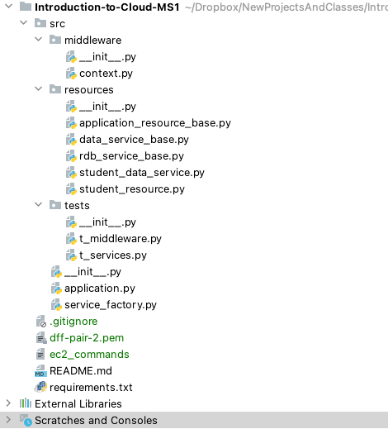
Simple Project Walkthroug (https://github.com/donald-f-ferguson/Introduction-to-Cloud-MS1.git)
This is not a great project structure. Ansys will evolve to a set of project templates.
Some comments:
The “base” stuffs’ source should not be in the project source.
I wrote this quickly but partially followed some patterns.
This is not a course on “good programming.”
I am an architect. I do not sully my mind with such mundane tasks.
There are environment variables.
The project is a really, really bad place for the key file, even if it is in .gitignore.

Slide 22
IaaS and Deployment
We will do many (most) of these tasks manually with commands or console.
Manual and UI helps visualize what is happening.
Automation and “infrastructure as code” will come later.
Create instance (EC2, Ubuntu) in VPC, security group.
Connect using ssh and key pair (get info from console)
Scroll through some_commands.md, .secret_stuff, app_env.sh
apt install
Mysql (and configure) (https://linuxbeast.com/tutorials/aws/how-to-install-mysql-on-amazon-ec2-ubuntu-18-04/)
Python
Git
Modify mysql bind rules in .cnf to enable remote access.
Deploy code from Git and set up environment.
Test.

Slide 23
Walk Through
https://ansys-aws-console.awsapps.com/start#/

Slide 24
Summary
24 | Introduction to Cloud Applications (I) – Lecture 1: Introduction, Concepts © Donald F. Ferguson, 2022

Slide 25
Summary
That as was fun. Let’s not do that again.
All of that was pretty tedious. In future lectures, we will learn:
Infrastructure-as-Code (https://en.wikipedia.org/wiki/Infrastructure_as_code) to enable automation and reuse.
Pipelines to automate tasks when development events occur, e.g. commit.
Higher layers in the cloud stack that make this MUCH simpler.
Containers and Container-as-a-Service
Platform-as-a-Service
We will also start using some more advanced concepts:
Security, secret management.
API management.
Service composition.
... ...

